Slide 1

MY SCHOOL
1.A
5.11. i 6.11.

Slide 2


LISTEN AND REPEAT (SLUŠAJ I PONOVI)

Slide 3


Slide 4


Slide 5


Slide 6


Slide 7
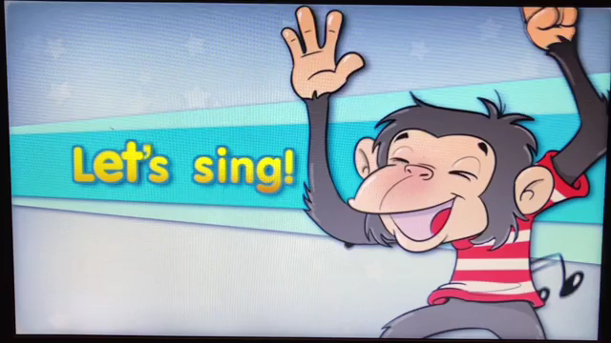
LISTEN TO THE SONG (POSLUŠAJ PJESMICU)

Slide 8

PLAY THE GAMES (ODIGRAJ IGRE)
https://wordwall.net/resource/5932675
https://matchthememory.com/cooktmyschool1

