Slide 1
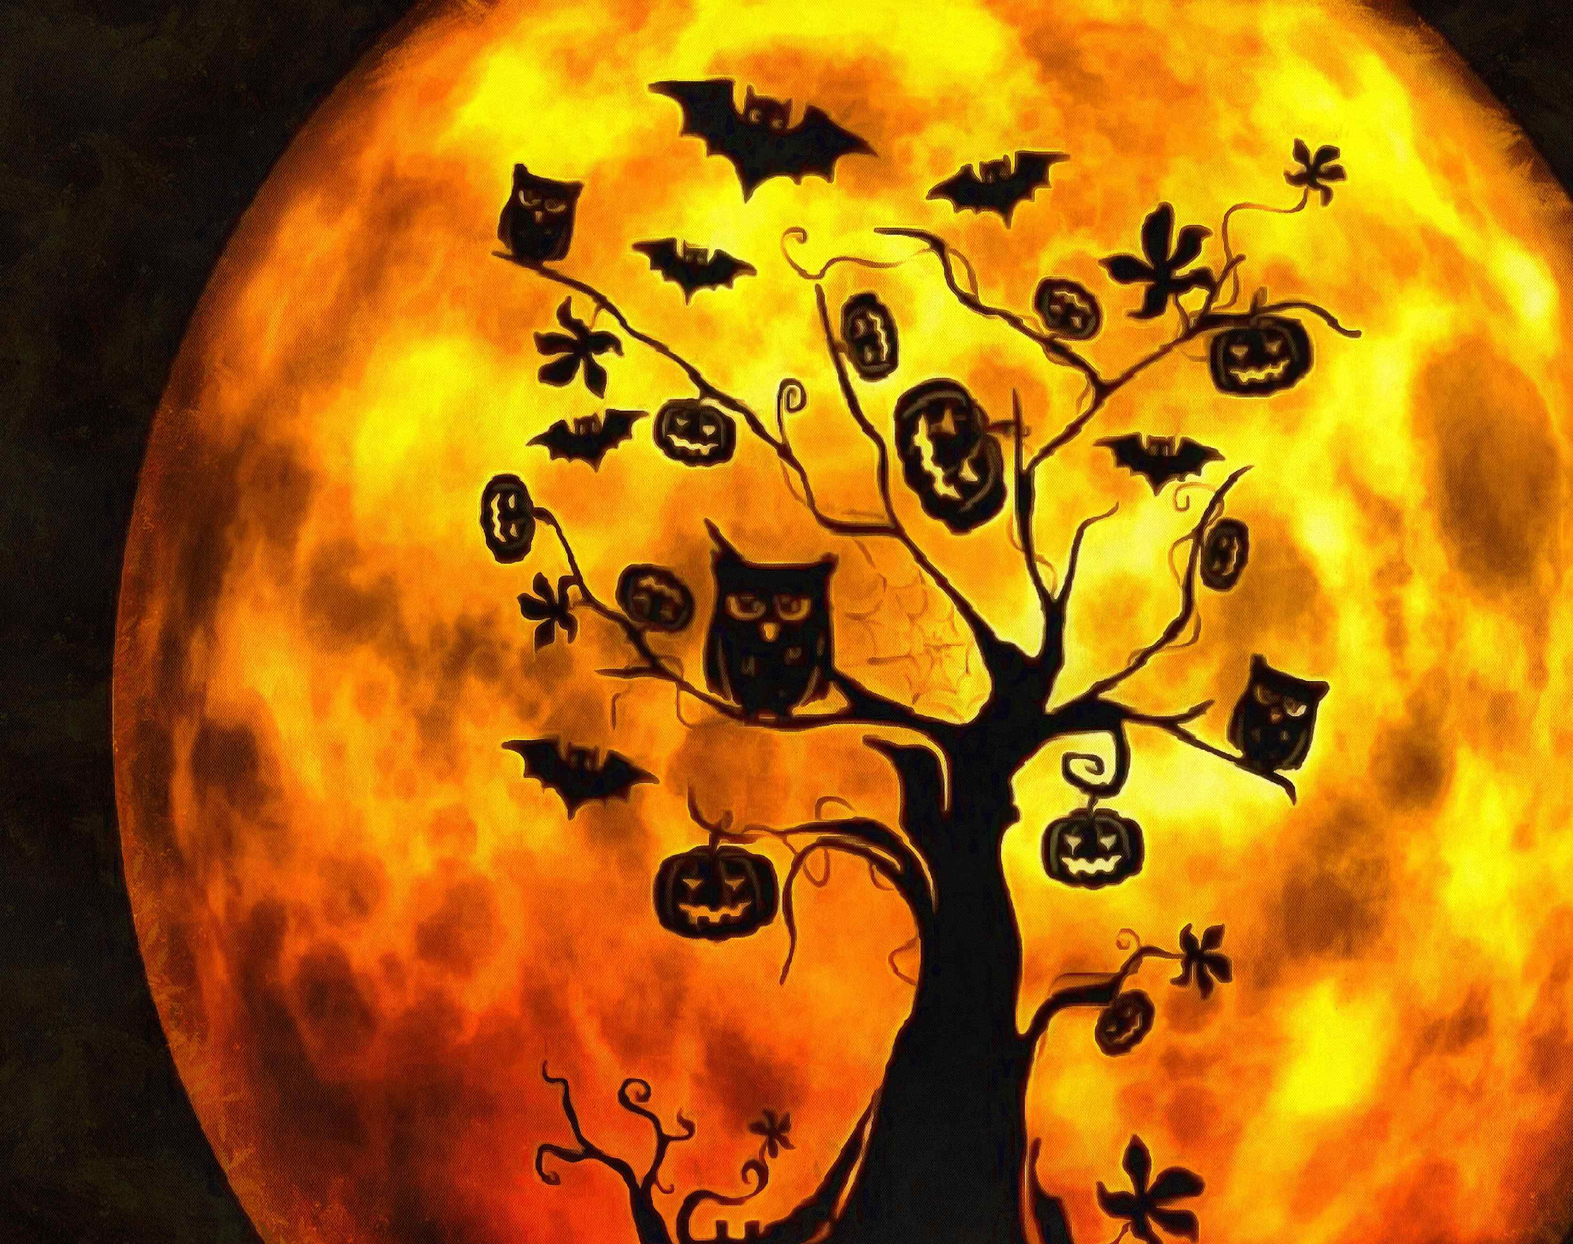
HAPPY
HALLOWEEN!
29.10.2020.

Slide 2
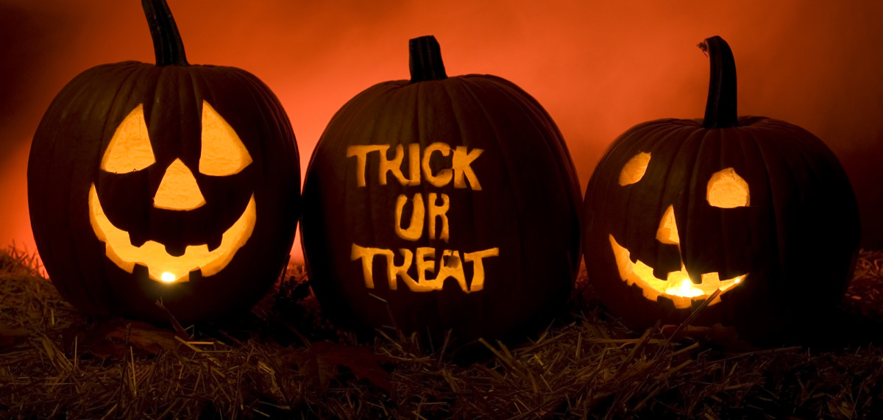
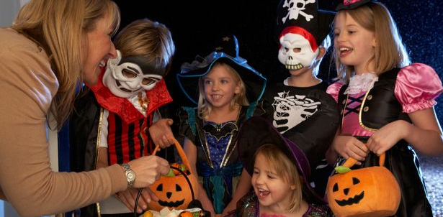
HALLOWEEN =
NOĆ VJEŠTICA
October 31st
(31.10.)

Slide 3
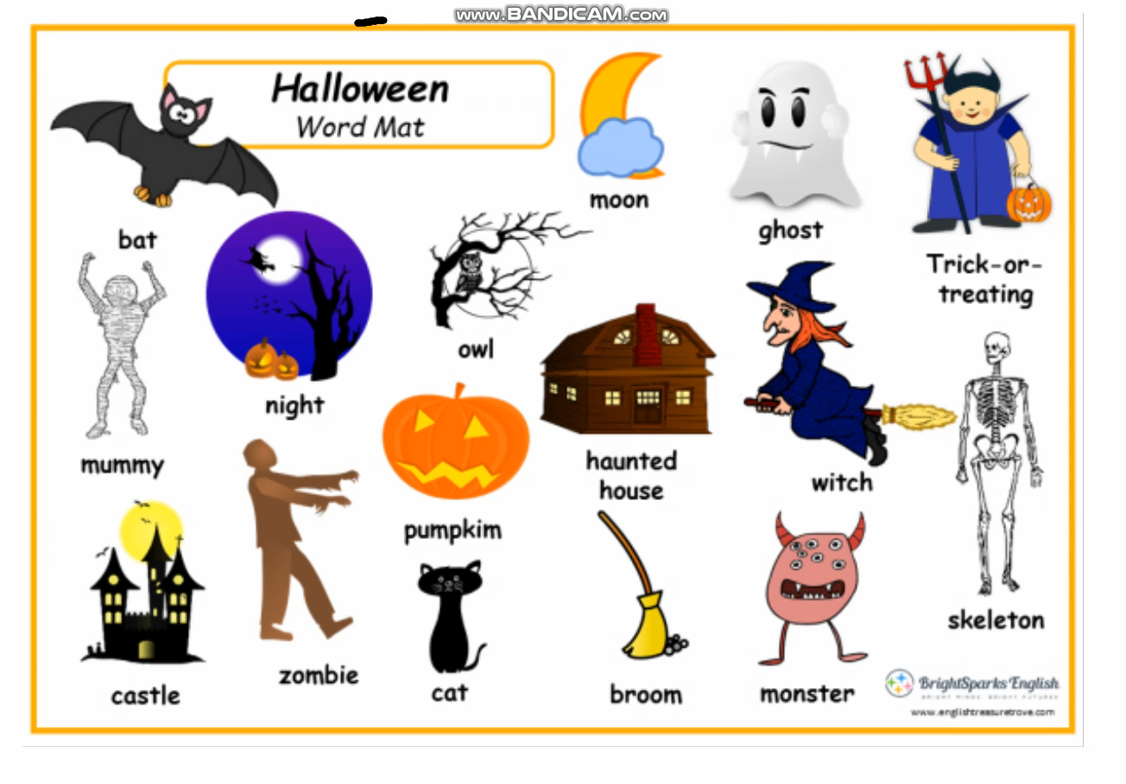
PRESS PLAY!

Slide 4
CAT = MAČKA
MOON = MJESEC
HAUNTED HOUSE = UKLETA KUĆA
BROOM = METLA
GHOST = DUH
WITCH = VJEŠTICA
MONSTER = ČUDOVIŠTE
SKELETON = KOSTUR
BAT = ŠIŠMIŠ
MUMMY = MUMIJA
CASTLE = DVORAC
NIGHT = NOĆ
ZOMBIE = ZOMBI
PUMPKIN = BUNDEVA
OWL = SOVA

Slide 5
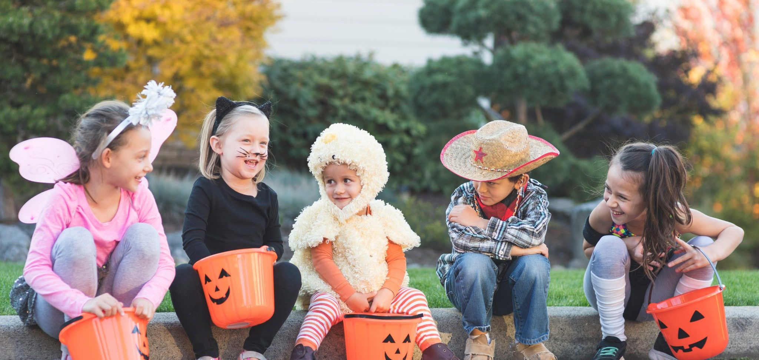
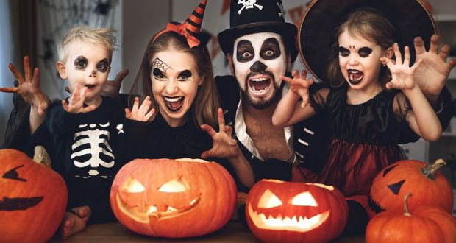
HISTORY OF HALLOWEEN
WATCH THIS VIDEO:
https://www.youtube.com/watch?v=W4uI3iMZyWc
(pogledajte video o povijesti Halloweena)

Slide 6
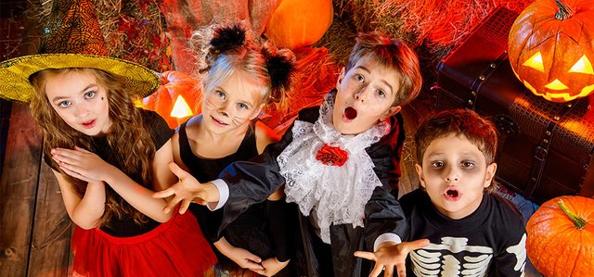
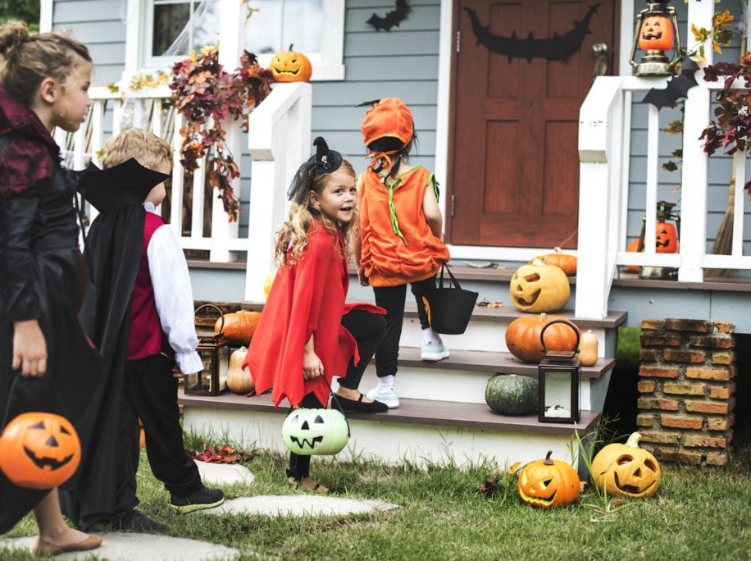
GAME TIME
HAVE FUN PLAYING THESE GAMES:
https://wordwall.net/resource/6023055
https://wordwall.net/resource/6023480
- Ne zaboravite napisati svoje ime na ljestvicu kad završite s igranjem ☺

